Slide 1
Partnering to Improve Veterans’ Health Care
Eric Shirley MD
White River Junction VA Medical Center

Slide 2
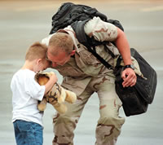
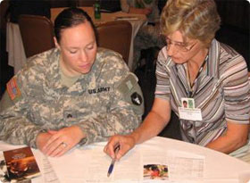
Why have we asked for your time today?
“Honor America’s Veterans by providing exceptional health care that improves their health and well-being”
Notes:
Anticipating the return of many Veterans to our communities, many of whom will get care in the community as well as at their local VHA.
Acknowledge that VA hasn’t always done a good job collaborating with community physicians and hospitals.
We would like to open a conversation about how we can collaborate better to manage care for our shared Veteran patients.

Slide 3
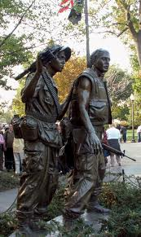
Notes:
Most of the attention currently goes to those involved with wars in Iraq and Afghanistan, but VA treats Veterans of all ages and from all conflicts.

Slide 4
What Do We Hope to Accomplish Today?
Present basic information about the VA and how VHA health care works
Discuss ways we can collaborate better in taking care of Veterans
How to get VA medical records
How to transfer a Veteran from your hospital to VA
How does the VA medication system work?
Understanding your concerns and issues about collaborating with the VHA.

Slide 5
About the Department of Veterans Affairs
Established in 1930
Elevated to Cabinet level in 1989
Federal government’s second largest department after the Department of Defense
Three components:
Veterans Health Administration (VHA)
Veterans Benefits Administration (VBA)
National Cemetery Administration (NCA)
Notes:
Third leg on Federally Funded healthcare stool

Slide 6
What is the VHA?
VHA is an entitlement program funded by Congress which may change depending on the Department of Veteran Affairs budget
VHA is not an insurance policy for veterans

Slide 7
VETERANS HEALTH ADMINISTRATION - VHA
LARGEST INTEGRATED HEALTH CARE SYSTEM IN THE COUNTRY
152 Hospitals
995 Clinics (Hospital, Community-Based, Independent and Mobile)
135
Community Living Centers
300 Readjustment Counseling Centers
VET CENTERS
103 Domiciliary Resident Rehabilitation Treatment Programs
Notes:
7
Comment: Need to give explanation of what these things are…what is a Vet Center, etc.

Slide 8
About the White River Junction VAMC
Serves about 22,000 Veterans
Total of 8 access points in VT and NH
Medical Center- White River Junction
60 beds: medicine, surgery, ICU, mental health
Most medical / surgical specialties
MRI / CT / interventional radiology
Strong DHMC affiliation
Women’s Comprehensive Care Center
CBOCs (Community Based Outpatient Clinics)
Colchester, Newport, Rutland, Brattleboro, Bennington, Keene, Littleton
Notes:
Each site puts in site-specific information

Slide 9
Our Purpose: To Provide Excellent Patient-Centered Care for Veterans
Build understanding between community healthcare organizations and local VHA facility
Improve communication by identifying appropriate contacts at VHA and in the community
Safe transitions of care to reduce hospital readmissions
Moving from “dual management” to “co-management” systems

Slide 10
Starting point: Ask your patients…
Did they serve in the military?
If they have, are they enrolled in VHA?
If not, suggest they contact the VA at www.va.gov for Veteran’s benefit information.
If they served in Iraq or Afghanistan, suggest they look at benefits information at http://www.oefoif.va.gov/index.asp

Slide 11
About VHA Primary Care
Patient Centered Medical Home model
Enrolled Veterans assigned to a Patient Aligned Care Team (PACT)
Primary Care Provider and the veteran’s PACT are the gateway to care and services at the VHA.

Slide 12
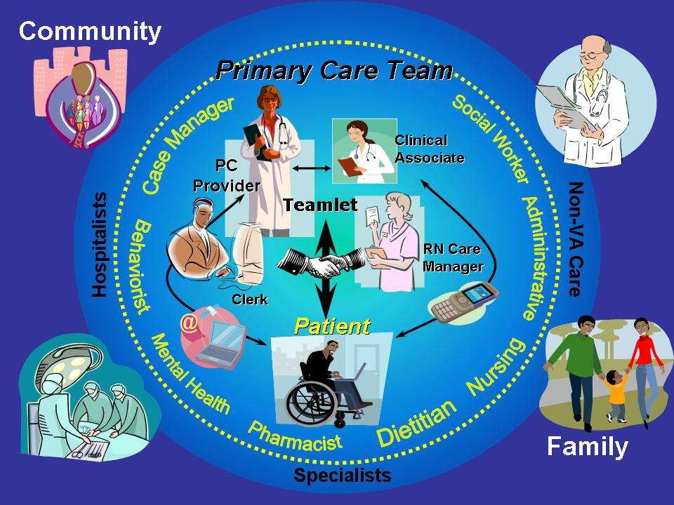
12

Slide 13
What do VHA Patients Pay for?
It varies:
If a healthcare problem was caused by the veteran’s military service, the VHA calls it “service connected” and the veteran receives free healthcare for that problem.
For other conditions, the VHA may charge a co-pay for healthcare visits, prescriptions, equipment or hospitalizations.
VHA bills Veterans’ commercial healthcare insurance for care unless it is service connected.
VHA is prohibited by law from billing Medicare or Medicaid.

Slide 14
Why is there Co-Managed Care?
Veterans enrolled in VHA care can use community healthcare services while maintaining their access to VHA benefits
50-70% of all enrolled Veterans are managed in partnerships with the private sector

Slide 15
Co-Management Challenges
Areas that are particularly challenging for community providers when working with VA:
Getting medications and supplies
Getting patient information from VA
Transferring inpatients to the VA
What does the VA pay for at non-VA sites?
Notes:
Comments: There are different issues for outpatient providers vs. hospitalists/ED. Need 2 distinct presentations
Reinforce idea of the POC at VA (i.e. case manager) who can best address these issues in a timely and appropriate way

Slide 16
Medications and Equipment
VHA Pharmacy only fills prescriptions written by VHA providers or VHA fee-based providers.
Veterans get medications and medical equipment from VHA only for conditions managed by VHA providers.
When Veterans ask their VHA provider to supply a medication prescribed by a community provider, the VHA provider reviews the clinical information available and/or schedules an appointment to see the Veteran because they will be medically responsible for the prescription. No medication will be dispensed until there has been this handoff.
Notes:
stress VA is a health care system, not a pharmacy

Slide 17
VHA Providers use the VHA Formulary
The VHA Formulary:
http://www.pbm.va.gov/NationalFormulary.asp
Primary Care Providers prescribe medications within their scope of practice.
Medications prescribed by a community specialty care provider (ophthalmologist, oncologist, rheumatologist, etc.) require a VHA specialty care provider to concur and write.

Slide 18
Example: Preferred Medications
VA Formulary | Not on VA Formulary
Simvastatin (1st line) Pravastatin Atorvastatin | Rosuvastatin
Omeprazole Ranitidine Famotidine | Lansoprazole Esomeprazole
Finasteride | Dutasteride
Symbicort | Advair

Slide 19
How Do I Contact VHA for Records?
Non-Urgent
Veteran can submit a Release of Information request to VHA to send information directly to the community provider
Request that the Veteran provide the information directly
Urgent
Mon-Fri 8:00 a.m. - 4:30 p.m.: Call White River Jct. VA Medical Center 866-687-8387 ext. 6364 and ask for Veteran’s PACT team.
Evenings, nights, weekends, holidays: Call White River Jct. VA Medical Center 866-687-8387 ext. 5700 for administrator on duty.
My HealtheVet option
Veteran prints information , secure messages the VHA provider to call, or can grant access to EMR

Slide 20
Notes:
Print is too small but may be useful as way to talk briefly about MHV

Slide 21
How Do I Transfer a Veteran Patient to the VA?
Veteran must qualify for inpatient acute care.
Ask Veteran if he/she desires to be transfer to a VAMC treating facility.
Referring physician must call admissions 802-295-9363 x 5700 24/7 directly. A checklist of medical information will be requested as a product of that call to determine eligibility and bed availability either locally or within the system.
The Admitting Physician of the day will then return the call directly to the referring physician. A doc to doc discussion will then determine disposition.

Slide 22
What will VHA pay for at non-VHA sites?
It varies and it is complicated.
If VA services are available, VA usually does not pay
If VA services not available, then there are circumstances where VA may pay
Managed by Fee Basis department- 802-295-9363 ext 5833
Millennium Bill (resources to care for uninsured Veterans)
Contact –Fee Basis for Millennium bill/fee services
within 72 hrs of care provision.

Slide 23
For More In-Depth Information: The 3-Hour Workshop
Learn more about the services available to eligible Veteran patients
Explore specific processes for accessing VA services, prescriptions, equipment & supplies, hospital discharge, transfers, and more
Discuss challenges faced by providers, case managers, nurses and other team members involved in co-managed care

Slide 24
Clinical Pearls
Ask “Are you a Veteran?” or “Did you serve in the military?”
Acknowledge military service
Ask about VHA PACT Team contact information, if VHA used
Encourage Veteran to use MyHealtheVet
Take a military history
Branch / Rank / Dates / Deployments / Job
Combat exposures
Illness / injuries while deployed

Slide 25
Resources for Health Professionals
VA / DoD Clinical Practice Guidelines
http://www.healthquality.va.gov
http://www.nationalresourcedirectory.gov/
http://www.pdhealth.mil/hcc/sapr.asp
http://www.womenshealth.va.gov/
Notes:
VEHU Classes?
Clinical Training available to community?

Slide 26
How to Contact Us
If you have any questions, please contact:
Telephone Advice Line 866-687-8387 ext. 6364
and request your Veterans PACT Team or Case Manager.
Department of Veterans Affairs
Medical Center
215 North Main Street
White River Junction, VT 05009
Notes:
Comment “When in doubt, call the case manager”

Slide 27
Questions & Answers
Notes:
Comment: Say, “we may not know all the answers but we will point you in the right direction”

